Slide 1
Welcome to Our Presentation

Slide 2
Name ID
Md. Foyzur Rahman 160103020051
Mustafizur Rahaman Khan 160103020060
Salman Hossain 160103020074
Course Code: CSE-200
Course Advisor: Pranta Sarkar
Lecturer(CSE) , NEUB

Slide 3
Project Name: Cafe Management System

Slide 4
Cafe Management System
About this Project :
Cafe Management System is desktop application software .Which is calculate sales products and make receipt for Customers and sellers.

Slide 5
We Use PYTHON in Our Project

Slide 6
Main Functionality :
Take Input
Calculate
Make Receipt

Slide 7
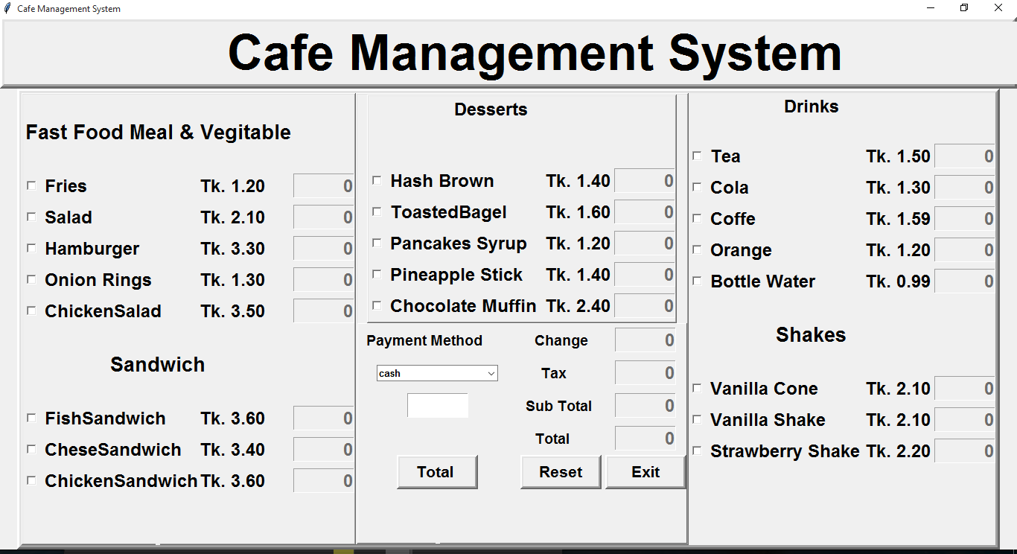

Slide 8
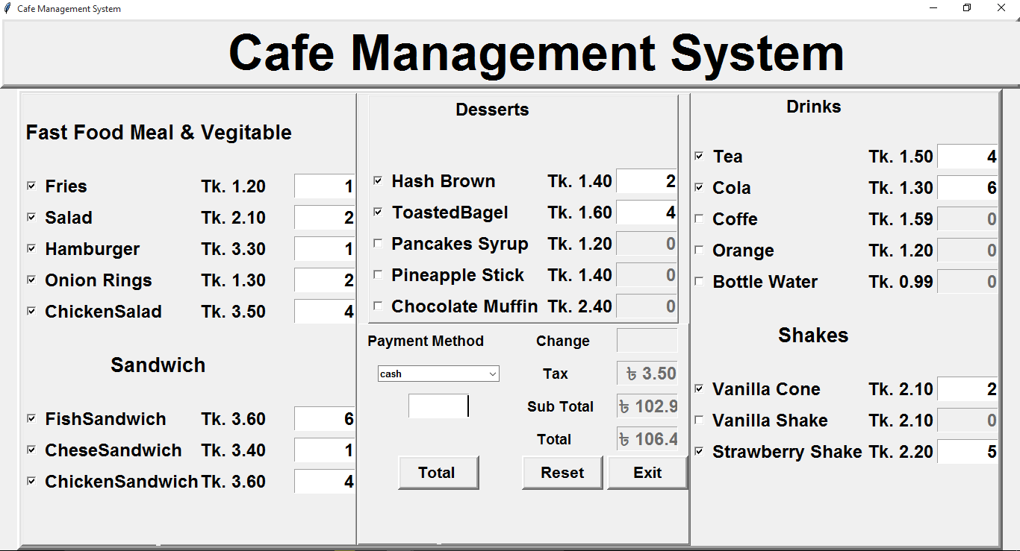

Slide 9
Thank You Everyone.

